Slide 1
Making Broadcasts Accessible Online
Instituut voor informatierecht (IViR)
A Study on the Copyright- Related Environment and Industry Practice
By: dr. Simone Schroff

Slide 2
The conundrum: making TV broadcasts accessible online
NISV holds 498,127 TV broadcasts (~2015) made by public service broadcasters
  Most have been digitised
  Only 2% are accessible online
Main reason: uncertainty about the copyright status
  Especially who can provide a license

Slide 3
The copyright issue
Making broadcasts accessible online requires 2 rights: reproduction and making available
  No exemptions are available for large scale project
Each TV broadcast is made up of a combination of copyright works and neighbouring rights
  Terms and right holders vary
  Creator- doctrine
Need to identify the right holder

Slide 4
 | Focus of Protection | First Owner | Term of Protection
Recurring features | Detailed storyline as combination of common themes | Author(s) | Death in 1945 | last surviving author died in 1945
 | Specific description of a format
 | Recognisable, detailed characters which are made up of a combination of specific features
Pre-existing works | Underlying novel etc
 | Script, representing the adaptation of the pre-existing work
News | Edited and corrected news statements
 | News programs as a whole
Spoken Words | Non-script based, spoken communication by an individual
 | Structured interviews
Music | Musical composition and lyrics |  | last surviving author died in 1945
Moving Images (film work) | Audio-visual work, meaning moving images with or without sound |  | last surviving author died in 1945: principal director, scriptwriter, author of the dialogue, composer of film music - if work was made before 1996: special rules
Notes:
Copyright works

Slide 5
 | Focus of Protection | First Owner | Term of Protection
Performance | Performance of a copyright work, with a minimum degree of personality | Performer | Fixation occurred after 1965 - if fixation on phonogram: fixation occurred after 1945
Phonogram | Recording of sound | Phonogram Producer | Recording was made after 1965 - if communicated to the public: fixation occurred after 1945
Fixation of Film | Recording of moving images, with or without sound | Film producer | Recording was made after 1965 - if distributed or communicated to the public: 50 years from that date
Broadcast | Transmission of work as a broadcast, both radio and TV | Broadcaster | Transmission was made after 1965

Slide 6
The doctrinal view
Large number of authors and right holders
Complicating factors:
  Special ownership rules
  Transfers
  Long timeframe: the law is not static
BUT: this is not what the data says

Slide 7
The information used in this project
Project had access to two distinct sets of empirical evidence
1) Schoon Schip empirical data
  Copyright status and rights division for a sub-set of TV broadcasters
  Holds information at season level on things like rights holder, exclusive rights, territory, duration and purpose of use
2) catalogue empirical data
  All of the broadcasts in NISV’s archive
  Records general information but also copyright-relevant roles e.g. author, scriptwriter, director, producer etc

Slide 9
company ownership by especially public service broadcasters and independant producers
What we don‘t see: individual authors holding the rights
Conclusion:
  The doctrinal analysis by itself is insufficient
  Public service broadcasting market practice concentrates the rights into the hands of few people
However, how this happens is important

Slide 10
Mechanism for rights concentration
Effect of this information crucially depends on how the broadcaster got hold of the rights
  1) via copyright law directly: the broadcaster is the ‘maker’
  2) transfer of rights: the broadcaster is the assignee or licensee of the rights, but not the ‘maker’
Difference: maker owns all rights, even new ones, while the assignment has to be interpreted as limited to the purpose of the contract
  Main issue is unknown uses: could be excluded from the transfer
  Full transfer is possible but increasingly unlikely
Main question: which mechanism explains the concentration of rights? How does it vary across time?
Notes:
Main research question essentially asks: what was common market practice?
Making works accessible is an unknown use at least until the early 1990s

Slide 11
Process-tracing: assessing the likelihood of alternative explanations
No dataset available to test the different explanations statistically
Process-Tracing: explain a given phenomenon by identifying the processes through which it is generated
  Process= more than one point in time
Each theoretical explanation (mechanism) is translated into observable characteristics
Process- tracing: see if mechanism‘s evidence is visible at different points in time
To use this methodology, each mechanism has to be highly conceptualised and indicators selected

Slide 12
Mechanisms relevant for TV broadcasts
Methodology: process- tracing to examine three mechanisms
  1) employment (art. 7 Aw and related provisions in WNR)
  2) first communication to public by legal entity (art. 8 Aw and related provisions in WNR)
  3) transfers (combination of articles, both copyright and neighbouring rights)

Slide 13
A mechanism in process-tracing
Step 1: conceptualise mechanisms → identify core observable characteristics
Step 2: mechanism across time → when and where more likely, least likely
  Amend/ expand observable characteristics
Step 3: carry out process tracing tests
  All mechanisms are equal

Slide 14
How does it work? (example: employment)
Step 1: conceptualise the mechanism
  Detailed doctrinal analysis of how the rules on employment have changed since 1912
  Focus on turning points → table

Slide 15
 | From 1912 | 1951 | 1973 | 1988
Legal Provision | In the course of employment, unless agreed otherwise
Interpretation | Relationship of authority: employer defines the tasks
 | Salary/ compensation
 | All works covered by employment
 | Explicit employment contract | Implicit Scope of Employment (Sense of Duty) |  | Implicit Scope of Employment (Sense of Duty) Creation of work is required by employer
Scholarly debate | Moral rights assumed owned by employer |  | Ownership of moral rights debated: tendency towards author ownership
 | Contracts to the contrary not discussed |  | Contracts to the contrary are increasingly relevant, including implicit ones
Notes:
This is an extract
Note that I divided it into:
Rule itself
Intepretation based on case law
Scholarly debate
- Legal interpretation matters more than scholarly debate → observable pattern more pronounced for the former than the latter

Slide 16
NWO Project: How does it work? (employment)
Step 1: conceptualise the mechanism
  Detailed doctrinal analysis
Step 2: identify observable characteristics that reflect the legal relevance
  Always in the form of hypothesis
  Special attention to turning points
Notes:
Turning points: usually not the same across mechanisms and therefore especially valuable in terms of affirming/ weakening hypotheses
Chosen indicators crucially depend on the kind of data or observations available

Slide 17
Examples of Hypotheses
E3: Due to the financial resources required, the author will most likely be a legal entity. This will most likely be a single entity.
E8: Permitting the author to put his name on a work can indicate an implicit contract, acting as a disincentive to the naming of authors (especially after 1973). Works of employment are therefore more likely to not have any author information.

Slide 18
NWO Project: How does it work? (employment article)
Step 1: conceptualise the mechanism
Step 2: identify indicators that reflect the legal relevance (hypotheses)
Step 3: test hypotheses
  Define test strength and data points
  Run the tests
Notes:
- Turning points: usually not the same across mechanisms and therefore especially valuable in terms of affirming hypotheses

Slide 19
Types of Test in Process- Tracing
In the social sciences: affirmation rather than confirmation
Process- tracing forces the researcher to think about
  Change across time
  Type of evidence (qualitative or quantitative)
  Strength of the test in terms of affirming hypothesis as well as relating to each other
Notes:
In the natural sciences: laws of nature always apply
In the social sciences: the best explanation known so far → absolute certainty is never possible

Slide 20





4 Types of Test: the ‘Puddle- Mystery‘
Straw in the Wind Test
Hoop Test
Smoking- Gun Test
Double Decisive Test

Slide 21
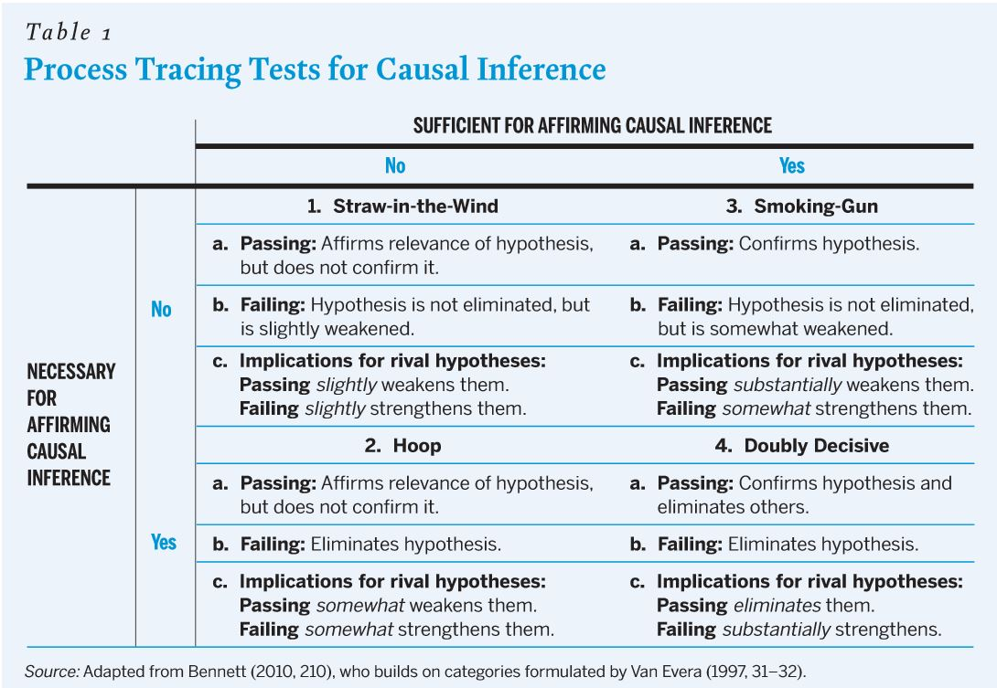

Slide 22
Example 1: Hoop Test
E3: Due to the financial resources required, the author will most likely be a legal entity.
Hoop test: look more for evidence to the contrary
  Other explanations exist for having only a legal entity but it is not theoretically likely that an individual acts as an employer in the context of broadcasting
Indicator: type of right holders that own exclusive rights
  Especially look for those where the right holder is an author

Slide 23
Only legal entities own TV broadcasts
Decade | Category of Right Holder |  |  | Total
 | Foreign Broadcaster | Independent Producer | Public Service Broadcaster
1950s | 0 | 5 | 180 | 185
1960s | 2 | 20 | 1111 | 1133
1970s | 8 | 41 | 783 | 832
1980s | 7 | 217 | 910 | 1134
1990s | 76 | 893 | 1993 | 2962
2000s | 48 | 1223 | 2283 | 3554

Slide 24
Example 2: Smoking Gun and Straw in the Wind Test
E8: Permitting the author to put his name on a work can indicate an implicit contract, acting as a disincentive to the naming of authors (especially after 1973). Works of employment are therefore more likely to not have any author information.
Straw Test: not naming authors
  Other explanations are possible
Smoking Gun Test: specific drop around 1973
  So theory specific and no alternative explanations relating to any theory or technical situation at NISV
Indicator: share of TV broadcasts that have at least one author qualifying role named

Slide 25
Naming authors in the 1970s
Year | At Least One Key Authorship Category
1971 | 11%
1972 | 10%
1973 | 8%
1974 | 7%
1975 | 9%
1976 | 9%
1977 | 10%
1978 | 12%
1979 | 16%

Slide 26
Example 3: constructing a double decisive
Under employment rules, the third party is the author: rights should be highly concentrated
  Series of individually tested hypotheses but the strongest case if they all occur at the same time
  Concentration highly unlikely under transfer rules
Indicator: combination of all exclusive rights, territory (at least the NL), full duration and all purposes of use

Slide 27
Fully concentrated rights
Decade | Full Rights | Total | Percentage
1950s | 64 | 179 | 36%
1960s | 740 | 1111 | 67%
1970s | 441 | 784 | 56%
1980s | 199 | 903 | 22%
1990s | 30 | 1902 | 2%
2000s | 10 | 2177 | 0%

Slide 28
Weighted Tests
Type of tests vary according to evidentiary value in relation to tested hypothesis as well as other hypothesis
  Absolute scores
  Weaker results
Weights applied:
  Straw test: 1
  Smoking Gun Test: 1.5
  Hoop test: 2
  Combined test: 3

Slide 29
Summary Methodology
Detailed doctrinal analysis of all provisions relating to either trasnfers or deviations from the creator doctirne
Translation of changes of into hypothesis which can be empirically tested
Empirical analysis based on weighted tests

Slide 30
Overall Number of Tests
 | Deviations from Creator Doctrine
Decade | Employment | Communication by public entity | Transfers
1950 | 15 | 15 | 6
1960 | 15 | 15 | 6
1970 | 16 | 15 | 9
1980 | 16 | 16 | 9
1990 | 15 | 15 | 10
2000 | 15 | 15 | 8

Slide 32
Area | Indicator | Test Type | 1950s | 1960s | 1970s | 1980s | 1990s | 2000s
ownership | Schoon Schip: Ownership by Legal Entity | Hoop
 | Schoon Schip: Single right holder | Straw
 | Catalogue: No contributor information | Straw
 | Catalogue: 1 producer and 1 broadcaster | Straw
rights concentration | Schoon Schip: average number of rights | Straw
 | Schoon Schip: Distinct Number of Rights | Straw
 | Schoon Schip: Type of right | Straw
 | Schoon Schip:identity of uses | Straw
 | Schoon Schip: number of distinct jurisdictions | Straw
 | Schoon Schip: identity of jurisdictions | Hoop
 | Schoon Schip: Duration | Straw
 | Schoon Schip: combined concentrated ownership | 4x Combined Smoking Gun
contract | Schoon Schip: contract present | Straw
importance of authors | Catalogue Data: broadcast without author | Straw
 | Catalogue Data: author categories | Straw
 | Catalogue Data: author categories (specified drop) | Smoking Gun
 | Catalogue Data: importance director | Smoking Gun
Notes:
1950s combined rights: many productions have no information at all rather than split rights

Slide 34
Area | Indicator | Test Type | 1950s | 1960s | 1970s | 1980s | 1990s | 2000s
Ownership | Schoon Schip: Ownership by Legal Entity | Hoop
 | Schoon Schip: single right holder | Straw
 | Catalogue: No contributor information | Straw
 | Catalogue: 1 producer and 1 broadcaster | Straw
Rights Concentration | Schoon Schip: average number of rights | Straw
 | Schoon Schip: Distinct Number of Rights | Straw
 | Schoon Schip: Type of right | Straw
 | Schoon Schip:identity of uses | Straw
 | Schoon Schip: number of distinct jurisdictions | Straw
 | Schoon Schip: identity of jurisdictions | Hoop
 | Schoon Schip: Duration | Straw
 | Schoon Schip: combined concentrated ownership | 4x Combined Smoking Gun
Reliance on Contracts | Schoon Schip: contract present | Straw
Importance of Authors | Catalogue Data: broadcast without author | Straw
 | Catalogue Data: author categories | Straw
 | Catalogue Data: importance director | Smoking Gun

Slide 36
Area | Indicator | Test Type | 1950s | 1960s | 1970s | 1980s | 1990s | 2000s | 2010s
ownership | Schoon Schip: Legal Entity | Straw
 | Catalogue: 1 producer and 1 broadcaster | Straw
rights concentration | Schoon Schip: average number of rights | Straw
 | Schoon Schip: average number of rights 1970s | Smoking Gun
 | Schoon Schip: Distinct Number of Rights | Straw
 | Schoon Schip: Type of right | Straw
 | Schoon Schip: identity of jurisdictions | Smoking Gun
contract | Schoon Schip: contract present | Straw
 | Schoon Schip: presence 1970s (status authors) | Straw
 | Schoon Schip: increase 1980s (article 45d) | Straw
 | Schoon Schip: increase 1990s (1992-1993 reforms) | Straw
importance of authors | Catalogue Data: broadcast without author | Smoking Gun
 | Catalogue Data: author categories | Smoking Gun
 | Catalogue Data: importance director | Smoking Gun
 | Catalogue Data: importance composer | Straw
 | Catalogue Data: importance performer | Straw

Slide 38
Conclusion
Until the 1980: TV broadcasts are most likely made by employment or communication by a public entity (both deviations from creator doctrine)
1980s: mixed picture
  Leaning towards deviations to the creator-based mechanisms but it depends on the individual production
After 1990: dominant mechanism is transfers

Slide 39
Implications: who owns the making available right?
Up until 1980: most likely the broadcaster
TV broadcasts made from the 1990s onwards
  Making available online covered in contracts+ presumption of transfer
Troublesome:
  TV broadcasts between 1980 and early 1990s: making available not likely to be part of contracts
  The more authors, the more difficult it gets

Slide 40
Thank you for your attention!

